Slide 1
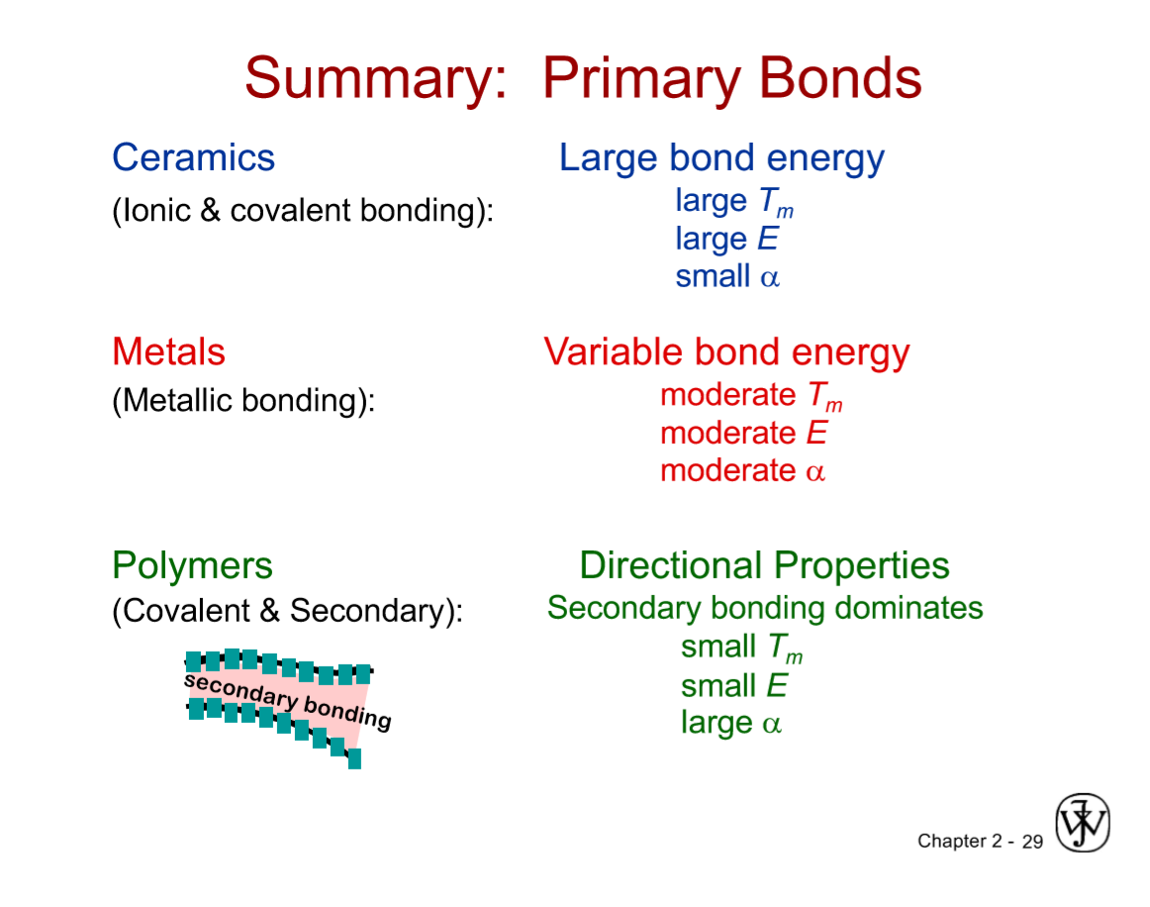

Slide 2
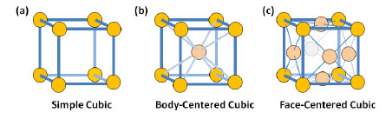
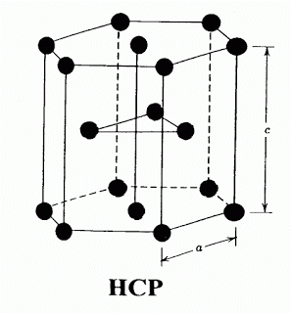
Each structure has its own atomic packing factor, relationship between atomic radius (r) and unit cell length (a).

Slide 3


Selenite Crystals in Naica, Mexico
Quartz Crystals – SiO2

Slide 4



Slide 5
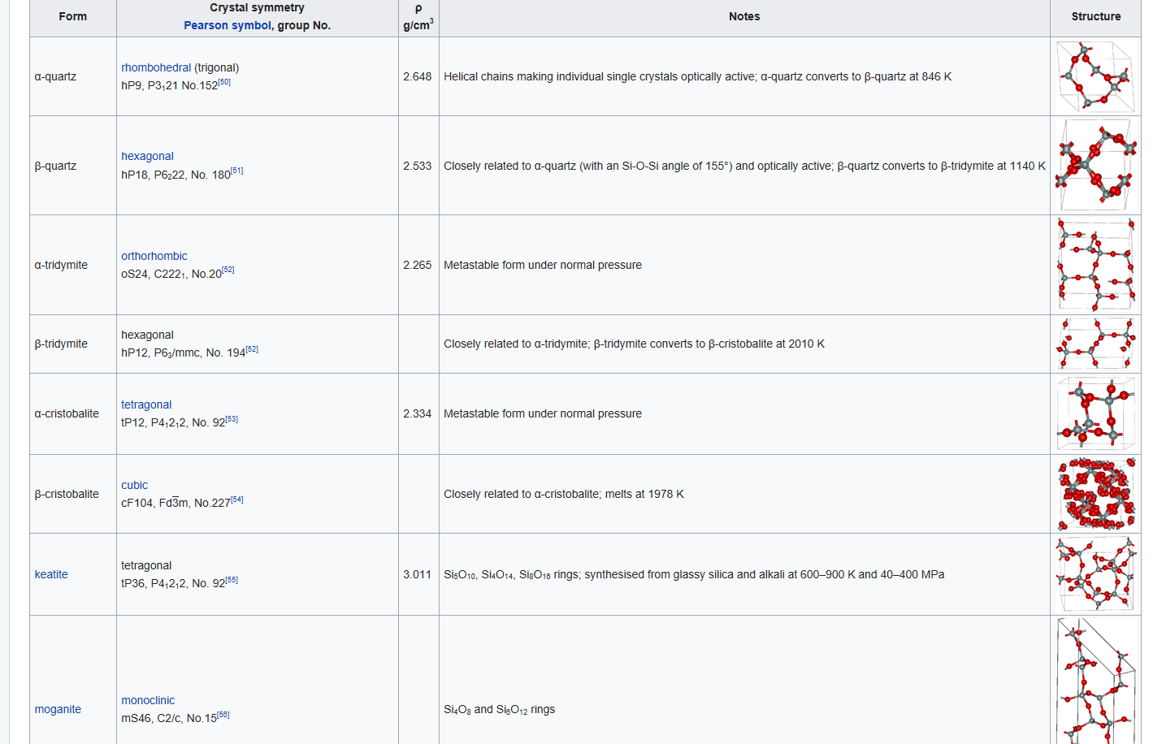
Chemical Composition & Structure (Polymorphism)

Slide 6
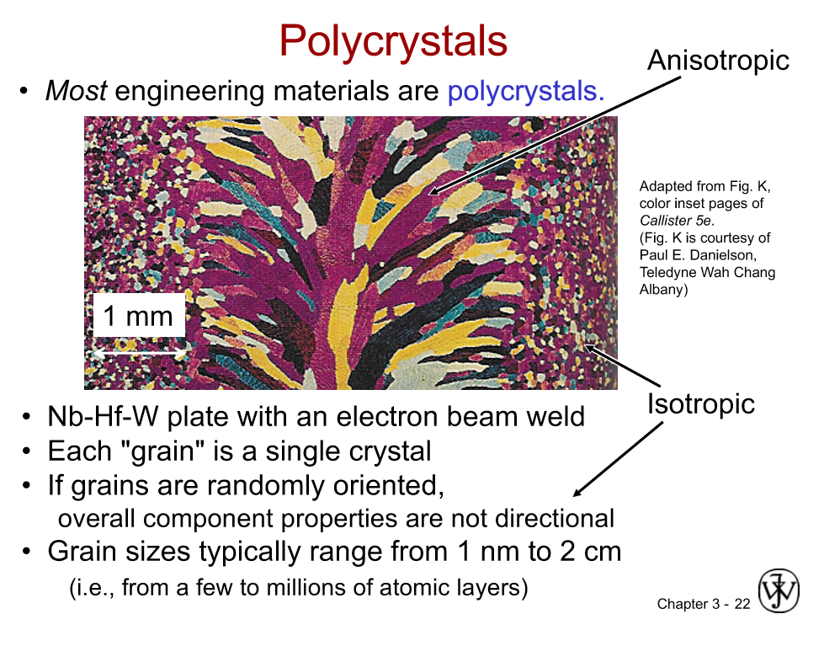

Slide 7
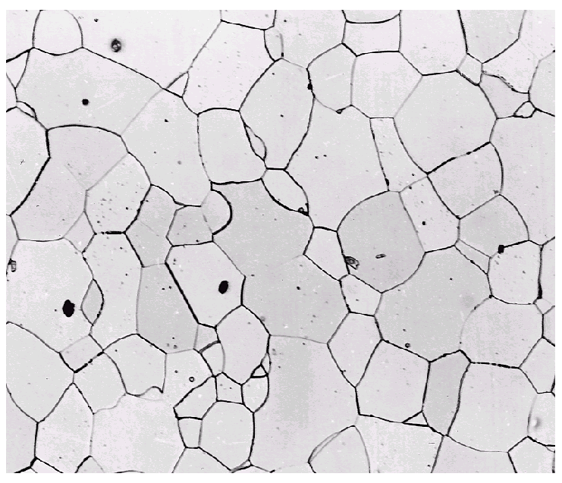

Imperfections in Solids
Solidification- result of casting of molten material
2 steps
Nuclei form
Nuclei grow to form crystals – grain structure
Start with a molten material – all liquid
nuclei
crystals growing
grain structure
liquid
Crystals grow until they meet each other

Slide 8
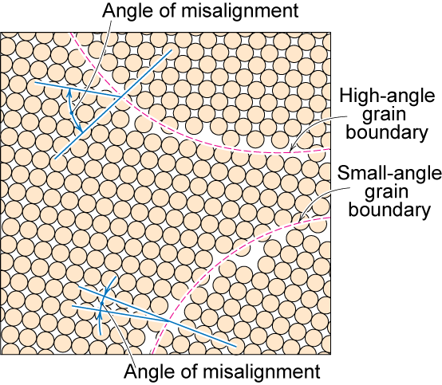
Polycrystalline Materials
Grain Boundaries
regions between crystals
transition from lattice of one region to that of the other
slightly disordered
low density in grain boundaries
high mobility
high diffusivity
high chemical reactivity

Slide 9
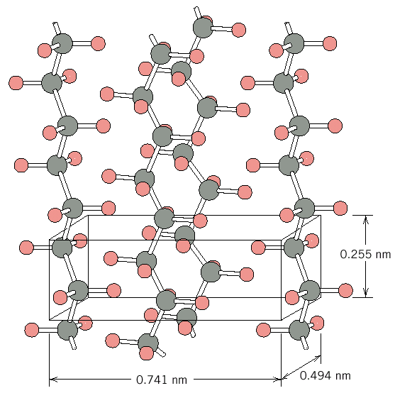
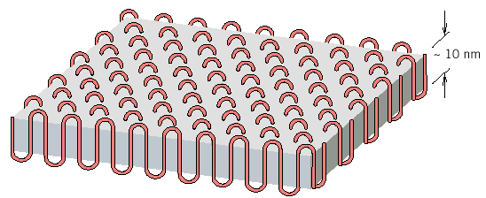
Polymer Crystallinity
Ex: polyethylene unit cell
Crystals must contain the polymer chains in some way
Chain folded structure
10 nm

Slide 10
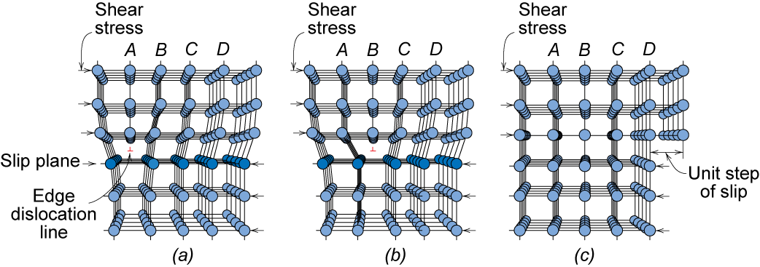
Dislocation Motion
Dislocations & plastic deformation
Cubic & hexagonal metals - plastic deformation by plastic shear or slip where one plane of atoms slides over adjacent plane by defect motion (dislocations).
If dislocations don't move, plastic deformation doesn't occur!
Adapted from Fig. 7.1, Callister 7e.
Notes:
So we saw that above the yield stress plastic deformation occurs. But how? In a perfect single crystal for this to occur every bond connecting tow planes would have to break at once! Large energy requirement
Now rather than entire plane of bonds needing to be broken at once, only the bonds along dislocation line are broken at once.

Slide 11
Strengthening Strategies
1. Grain Size
2. Alloying
3. Precipitates
4. Dislocations

Slide 12
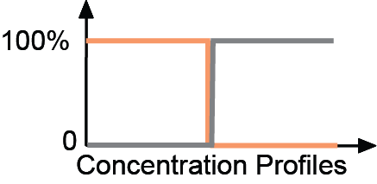
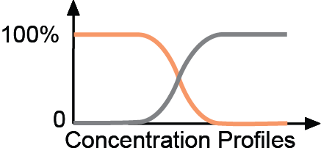
Solid-state Diffusion
• Interdiffusion: In an alloy, atoms tend to migrate
from regions of high conc. to regions of low conc.
Initially
After some time

Slide 14
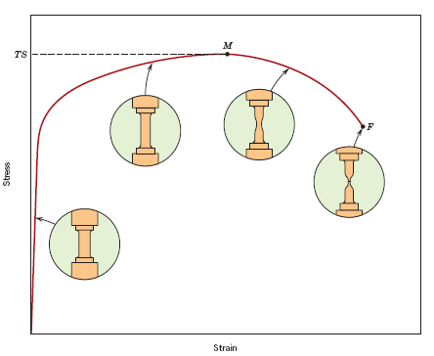
Tensile Strength, TS
• Maximum stress on engineering stress-strain curve.
TS
F = fracture or
ultimate
strength
Neck – acts as stress concentrator
σ_{y}
stress
engineering
Typical response of a metal
strain
engineering strain
• Metals: occurs when noticeable necking starts.
• Polymers: occurs when polymer backbone chains are
aligned and slip past one another.

Slide 15
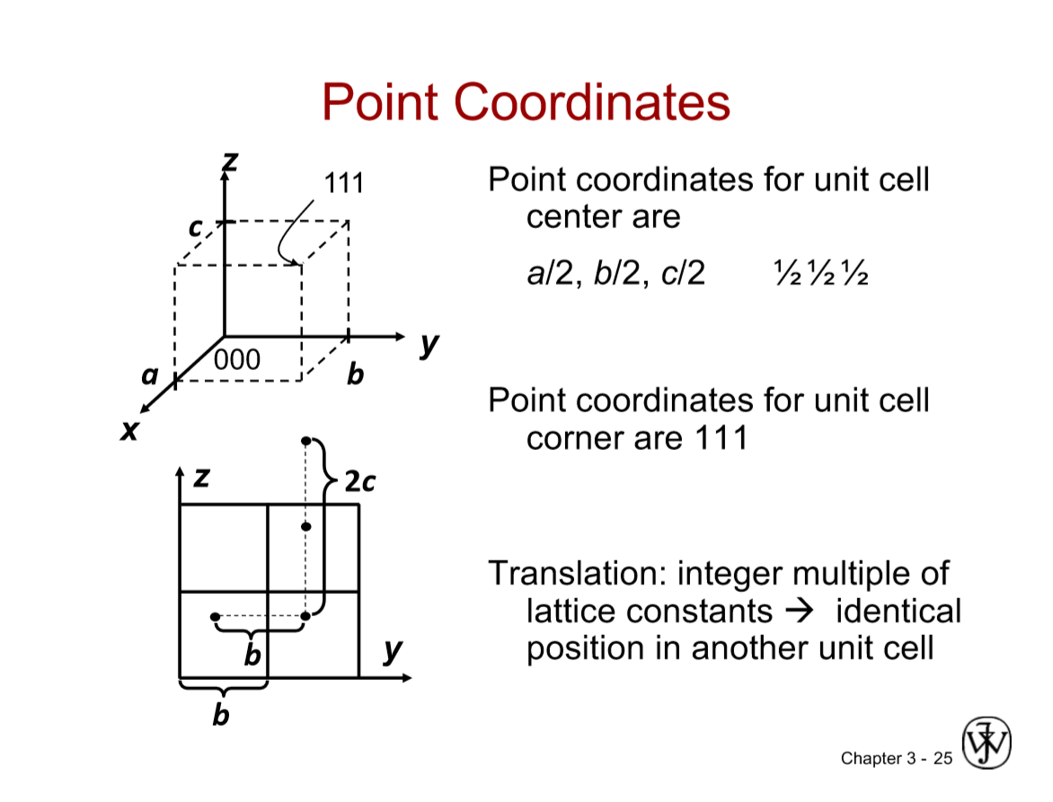

Slide 16
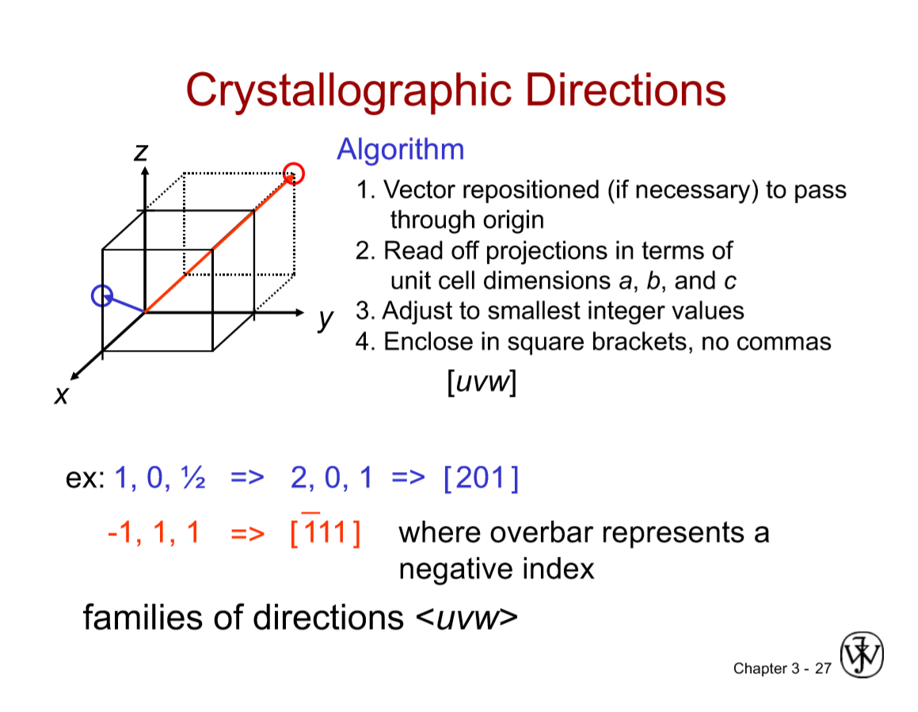

Slide 17
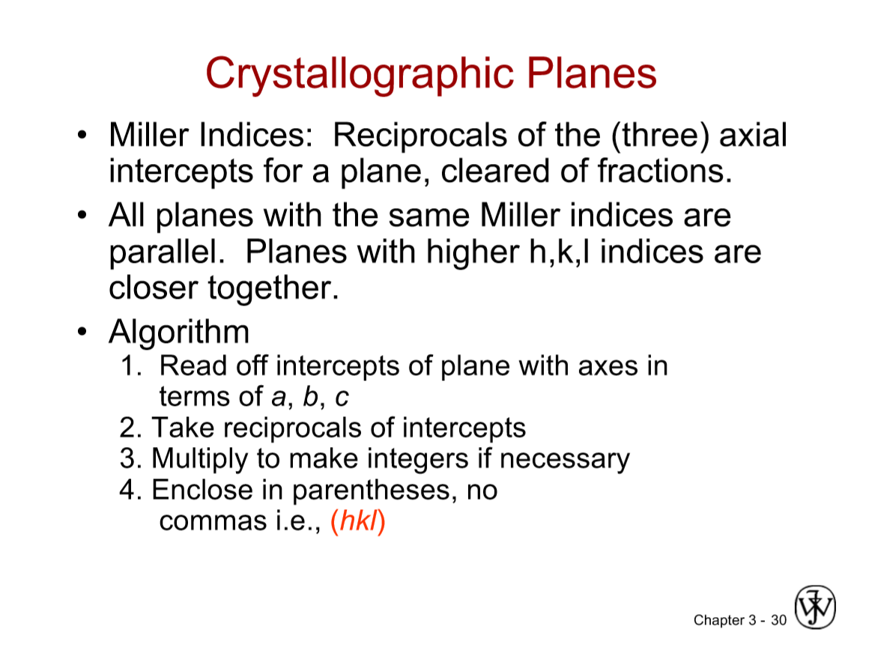

Slide 18
Exam I Review
MSEG 302 Spring 2018
Prof. David C. Martin

Slide 19
Chapter 1: Overview
Introduction to Materials Science and Engineering
Metals, Polymers, Ceramics
Application: Hip Implant
Mechanical Properties vs. Density
Electrical, Magnetic, Optical Properties
Deterioration
Selection: Application -> Properties -> Materials -> Processing

Slide 20
Chapter 2: Bonding
Atoms: protons, mass, electrons
Wave functions, energy levels
Electronic structure
Periodic table, electronegativity
Ionic bonds, potential energy of interactions
Metallic bonds
Covalent bonds
sp³, sp² hybridization, chirality
Structure, properties from bond energy curves: r₀, T_{m}, α, E

Slide 21
Chapter 3: Crystals
Unit cell: a, b, c, α, β, γ
SC, BCC, FCC, HCP
Density = mass / volume
Single crystals, polycrystals
Polymorphism
Crystal point coordinates x, y, z; directions [hkl], planes (hkl)
Linear and planar densities
X-ray diffraction

Slide 22
Chapter 14: Molecules and Polymers
Long-chain molecules
Molecular weights, Mn, Mw
Hydrocarbons, sp² -> sp³
Chain-growth, step-growth polymerizations
Common reactions, molecular structures
Tacticity
Copolymers
Amorphous vs. Semi-crystalline materials
Degree of Crystallinity

Slide 23
Chapter 4: Defects
Point Defects: vacancies, interstitials, substitutions
Line Defects: dislocations: edge, screw
Area Defects: grain boundaries, surfaces
Structure, energetics, mobility, influence on properties
Composition by weight/mass, mole/number, volume
Microscopy: optical, electron, scanned probe

Slide 24
Chapter 5: Diffusion
Diffusion coefficient D = x²/t
Temperature dependence: D= D₀ exp(-Q_{d}/RT)
Mechanisms of Diffusion
Fick’s 1st law: J = -D dc/dx (steady-state)
Fick’s 2nd law: dc/dt = D d²c/dx² (non-steady-state)
Dependence of D on structure, bonding, density, temperature, atom size

Slide 25
Chapter 6: Mechanics
Engineering stress, strain
Linear, non-linear deformation
Elastic, plastic deformation
Tensile modulus E, Poisson’s ratio v
Shear modulus G, Bulk modulus K
Yield strength (0.2% plastic strain, 0.5% total strain)
Tensile strength
Resilience

Slide 26
Chapter 6: Mechanics continued
Ductility
Energy to Failure
Hardness testing
True stress, strain
Hardening
Variability: means, standard deviations
Safety factors in design

Slide 27
Chapter 7: Deformation Mechanisms
Dislocations and slip
Critical resolved shear stress
Grain size
Alloying
Precipitates
Cold working
Annealing: Recovery, Recrystallization, Grain-Growth

